Slide 1

Offering Microsoft Azure Stack Hub Resources
Working with Offers, Plans and Quotas
This work is licensed under a Creative Commons Attribution - ShareAlike 4.0 International Public License

Slide 2
Managing Access to Azure and Azure Stack Hub Resources

Slide 3
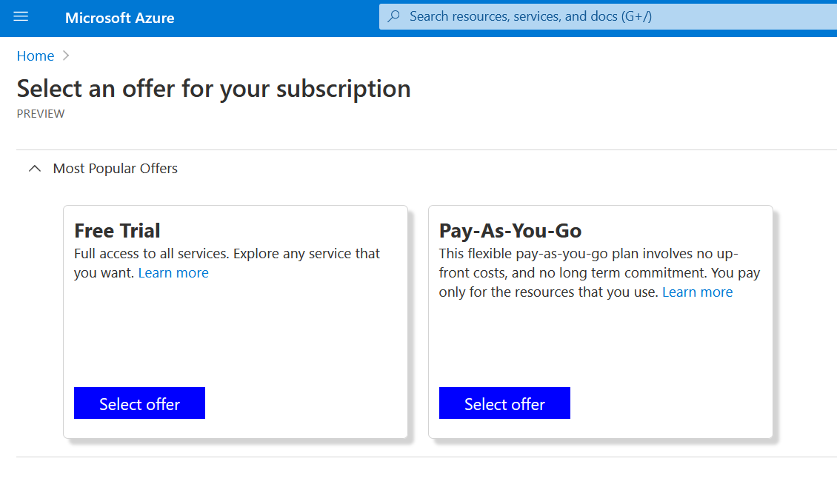
Getting started
Question
How do users in AZURE get a subscription to begin with?
Azure answer:
Through the creation of offers, plans and quotas
In AZURE, this is what a user would see when requesting a new subscription
When users “sign up” for Azure, they subscribe to an offer.

Slide 4
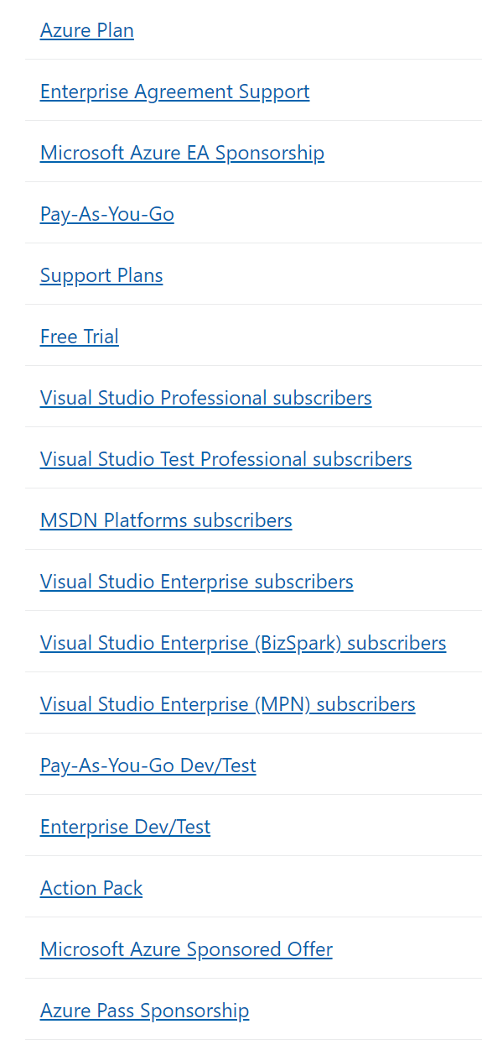
Offers, quotas, and subscriptions in Azure
Azure presents several offers:
Pay-As-You-Go
Enterprise Agreement (EA)
MSDN
Trial
etc.
Offer Details | Microsoft Azure

Slide 5
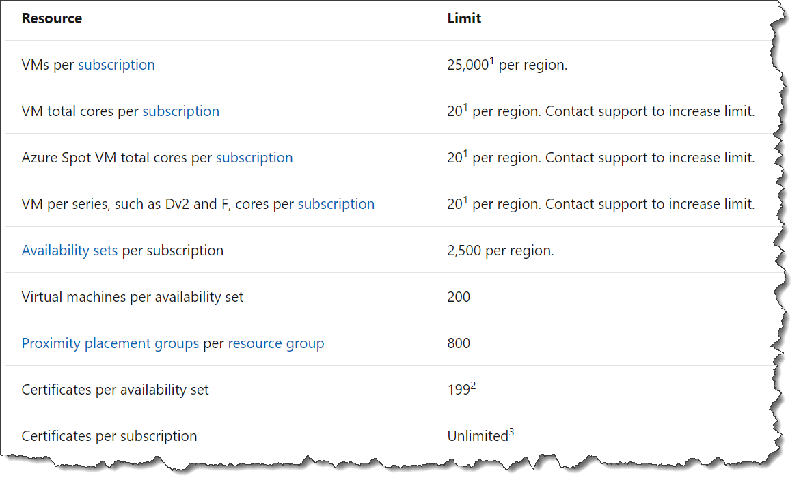
Offers, quotas, and subscriptions in Azure
Quotas (limits on allowed usage) are associated with offers defined within AZURE
Note: limits shown here are for Azure and are from aka.ms/Azure/Limits

Slide 6
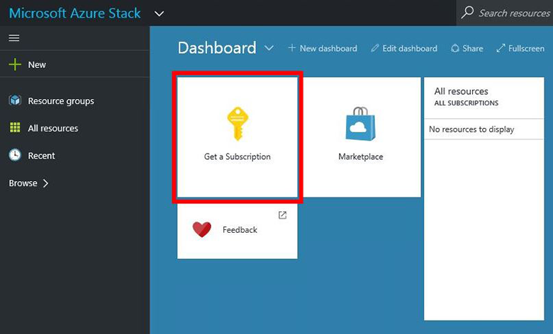
Managing access to resources in Azure Stack Hub
The problem:
How do you, as an Azure Stack Hub Operator, manage the resources a user can consume?
The Azure Stack Hub answer:
Like in Azure through subscriptions and offers, and you are the admin and you define the offers
Plus, you can empower resellers to sign up their own customers

Slide 7
Managing Access to Azure Stack Hub Resources

Slide 8

In Azure Stack Hub environments, you are the Provider
You define quotas, plans and offers
You set quotas specific to each offer
You define your business model
Azure Stack Hub
Azure Stack Hub services, plans, offers, subscriptions overview - Azure Stack Hub | Microsoft Docs

Slide 9
Resource…..
Services/Resources
Compute
Storage
Network
AppService
…..

Slide 10
Resource, Quota….
Services/Resources
Quotas
What’s a quota?
Compute
Compute Quota - small
Storage
Compute Quota - large
Quotas determine the upper limit to the resources a subscriber can consume
You may create multiple levels of quota for the same resource.
You can either modify an existing quota (to give all quota-holders more access to resources) or move selected users to a different quota (to give only some users more quota)
Network
Storage Quota
AppService
Network Quota
…..
AppService Quota

Slide 11
Resource, Quota…Plan
What’s a Plan?
Quotas
Plan #1 – VMs
Compute Quota – small
Compute
Storage
Plans are used to group several quotas together as a logical unit
For instance, a plan for a mobile phone carrier would tie together quotas for text messages, voice minutes, and data. This is a similar idea to plans in Azure Stack Hub
You can think of plans as the levels of service capacity that you might offer users. The quotas are the granular controls, and plans tie them together into more general groupings
Compute Quota – large
Network
Storage Quota
Plan #2 – Increase Compute quota
Network Quota
Compute
AppService Quota
Plan #3 – Web
AppService
Quotas determine the limit to the resources a subscriber can consume

Slide 12
Resource, Quota, Plan….Offer
Plan #1 – VMs
Offer #1 – IaaS only
What’s an Offer?
Base
Plan #1
Compute
Storage
Offers are used to make one or more plans available to users
An offer can have a Base Plan and zero or more Add-On Plans associated with it. So you can include multiple plans in one offer
You can see at the left, how you can have offers for IaaS only, or form an IaaS and Web Offer by combining multiple plans
Offers are the things that users see when they sign up for Azure or Azure Stack Hub
Network
Offer #2 – IaaS and Web
Plan #2 – Increase Compute quota
Base
Plan #1
Compute
Add On
Plan #2
Plan #3 – Web
AppService
Add On
Plan #3
Plans are used to group quotas together

Slide 13

Offer – a closer look
Offers have 3 states:
Public: Visible to users.
Private: Only visible to the cloud administrators. - Use this state while drafting the plan or offer, or if the cloud administrator wants to approve every subscription.
Decommissioned: Not able to be subscribed (The cloud administrator can use decommissioned to prevent future subscriptions, but leave current subscribers untouched

Slide 14
Resource, Quota, Plan, Offer…Subscription
Offer #1 – IaaS only
Base
Plan #1
Subscription 1
What’s a Subscription?
Subscriptions are how users (users or groups of users) sign up to offers
When a user or organization first starts to use Azure Stack Hub resources, they must choose an offer and subscribe to that offer
Offer #2 – IaaS and Web
Subscription 2
Base
Plan #1
Add On
Plan #2
Subscription 3
Add On
Plan #3
Offers are used to make one or more Plan available

Slide 15

Plans, offers, and subscriptions in Azure Stack Hub
Services
Quotas
Plan #1 – VMs
Offer #1 – IaaS only
Base
Plan #1
Subscription 1
Account 1
user@contoso. onmicrosoft.com
Compute
Compute Quota – small
Compute
Compute Quota – large
Storage
Storage
Account 2
user2@contoso. onmicrosoft.com
Network
Offer #2 – IaaS and Web
Network
Subscription 2
Storage Quota
Base
Plan #1
Account 3
user3@fabrikam. onmicrosoft.com
AppService
Plan #2 – Increase Compute quota
Network Quota
Subscription 3
…..
Add-On
Plan #2
Compute
AppService Quota
Plan #3 – Web
Subscriptions are how users sign up to Offers
Add-On
Plan #3
AppService
Quotas determine the limit to the resources a subscriber can consume
Plans are used to group quotas together
Offers are used to make one or more Plan available

Slide 16
A customer-centric view of the same thing…
Subscription A
Offer ‘J’ – IaaS and Web
Plan #1 – VMs
Quotas
Services
A user may consume multiple subscriptions
Base
Plan #1
Compute
Compute
A subscription must map to just one offer
Compute Quota – small
Storage
Compute Quota – large
Storage
Add On
Plan #2
Network
Network
Add On
Plan #3
Storage Quota
Plan #2 – Increase Compute quota
AppService
Network Quota
Your customers may want multiple subscriptions to divide test vs prod, or to create distinct billing categories
An offer contains one or more plans
Compute
…..
AppService Quota
A plan in an offer can be a base plan, or an add-on plan that subscribers can add later
Plan #3 – Web
AppService
Plans access services with a quota that limits how much resource can be consumed
Services are metered

Slide 17
Defining quotas
Resource Provider | Configurable quotas | Default quotas
Compute | Yes | Default
Health | No | None
Key Vault | No | Unlimited
Network | Yes | Default
Storage | Yes | Default
MySQL | Yes | None
SQL | Yes | Default Basic Default Standard Default Premium Default Admin
App Service | Yes | Default
Event Hubs | Yes | Default
IoT Hub | No | S2 & S3
Quotas = how much of each service we want to allow users to consume
Each resource provider will have quotas configured
Quotas can contain upper limits only
Balance quotas with available capacity
A basic view of capacity available in Region Management
Quotas and quota types in Azure Stack Hub - Azure Stack Hub | Microsoft Docs

Slide 18
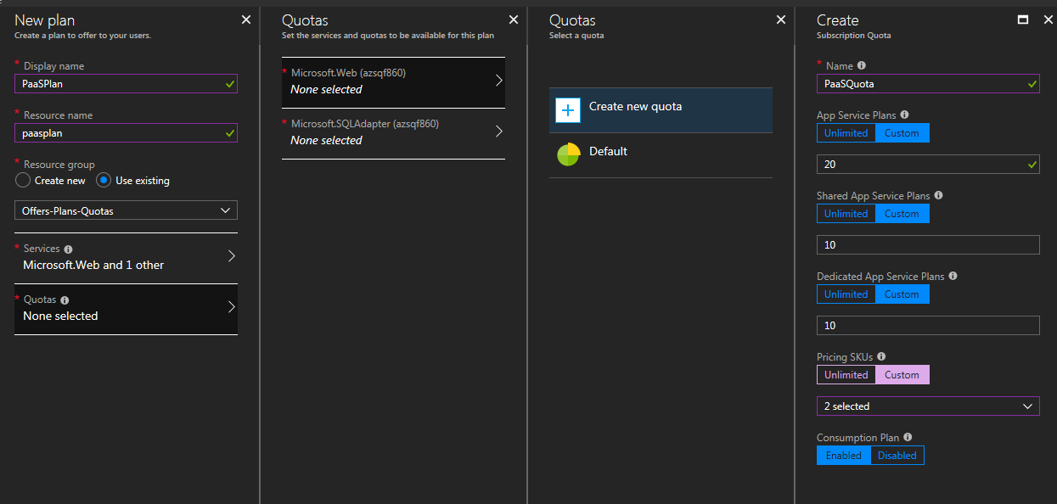
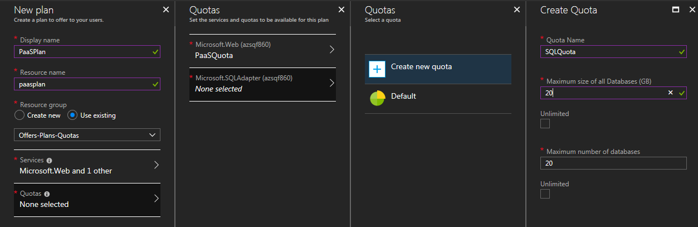
Showing quotas
Each Resource Provider can show its own quotas
SQL Quotas
App Service Quotas

Slide 19
IaaS Quotas
Compute
Type | Default value | Description
Max number of virtual machines | 50 | The maximum number of virtual machines that a subscription can create in this location.
Max number of virtual machine cores | 100 | The maximum number of cores that a subscription can create in this location (for example, an A3 VM has four cores).
Max number of availability sets | 10 | The maximum number of availability sets that can be created in this location.
Max number of virtual machine scale sets | 100 | The maximum number of virtual machine scale sets that can be created in this location.
Maximum capacity (in GB) of standard managed disk | 2048 | The maximum capacity of standard managed disks that can be created in this location. This value is a total of the allocation size of all standard managed disks and the used size of all standard snapshots.
Maximum capacity (in GB) of premium managed disk | 2048 | The maximum capacity of premium managed disks that can be created in this location. This value is a total of the allocation size of all premium managed disks and the used size of all premium snapshots.

Slide 20
IaaS quotas
Network
Item | Default value | Description
Max public IPs | 50 | The maximum number of public IPs that a subscription can create in this location.
Max virtual networks | 50 | The maximum number of virtual networks that a subscription can create in this location.
Max virtual network gateways | 1 | The maximum number of virtual network gateways (VPN Gateways) that a subscription can create in this location.
Max network connections | 2 | The maximum number of network connections (point-to-point or site-to-site) that a subscription can create across all virtual network gateways in this location.
Max load balancers | 50 | The maximum number of load balancers that a subscription can create in this location.
Max NICs | 100 | The maximum number of network interfaces that a subscription can create in this location.
Max network security groups | 50 | The maximum number of network security groups that a subscription can create in this location.
aka.ms/AzureStack/Quotas

Slide 21
IaaS Quotas
Storage
Item | Default value | Description
Maximum capacity (GB) | 2048 | Total storage capacity that can be consumed by a subscription in this location. This value is a total of the used size of all blobs (including unmanaged disks) and all associated snapshots, tables, queues..
Total number of storage accounts | 20 | The maximum number of storage accounts that a subscription can create in this location.
Event Hubs
Type | Default value | Description
Maximum number of VM cores | 10 | The maximum number of cores that a subscription can create in this location (for example, an A3 VM has four cores).

Slide 22


Locks and tags
You can apply a lock to an item so that it cannot be accidentally deleted in the portal without first unlocking it
You can also apply a tag to an item in the portal, like a customer name for a subscription. It’s a free-form key/value pair so you could enter e.g. customer/Contoso or expiry/24-Sept-2017
Maximum 15 tags per item (will change to 50 in a future release to match the new Azure tag limit)
You can later use the tags as a filter to apply policy…

Slide 23
Putting It All Together

Slide 24
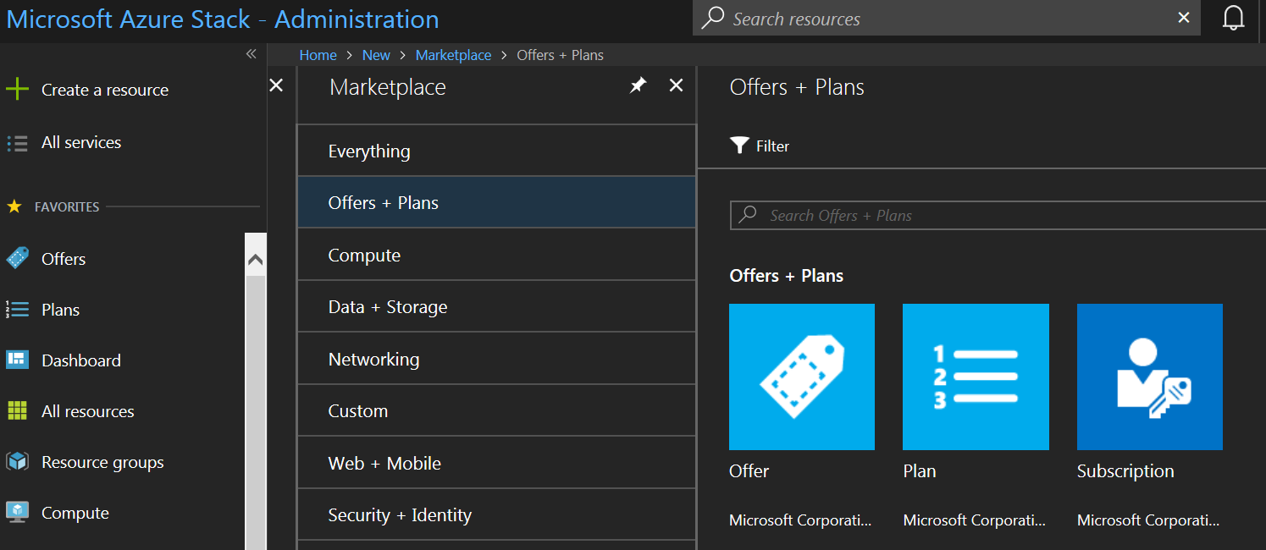
Starting point

Slide 25
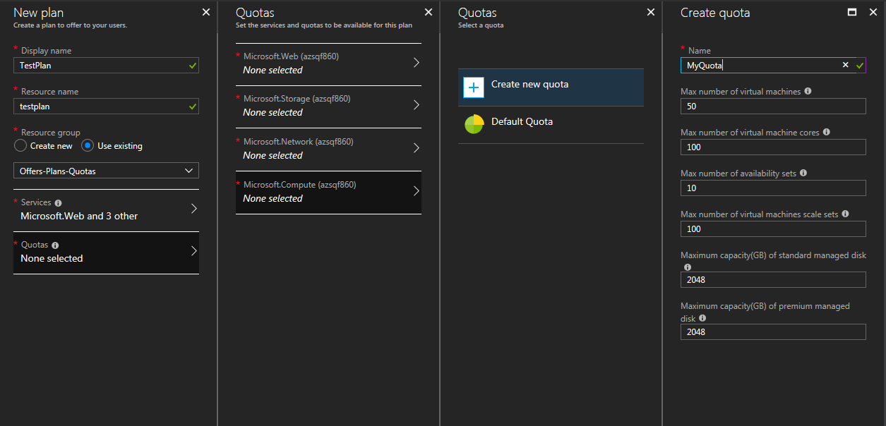
1 – Create a quota
Described here: https://docs.microsoft.com/en-au/azure/azure-stack/azure-stack-plan-offer-quota-overview

Slide 26
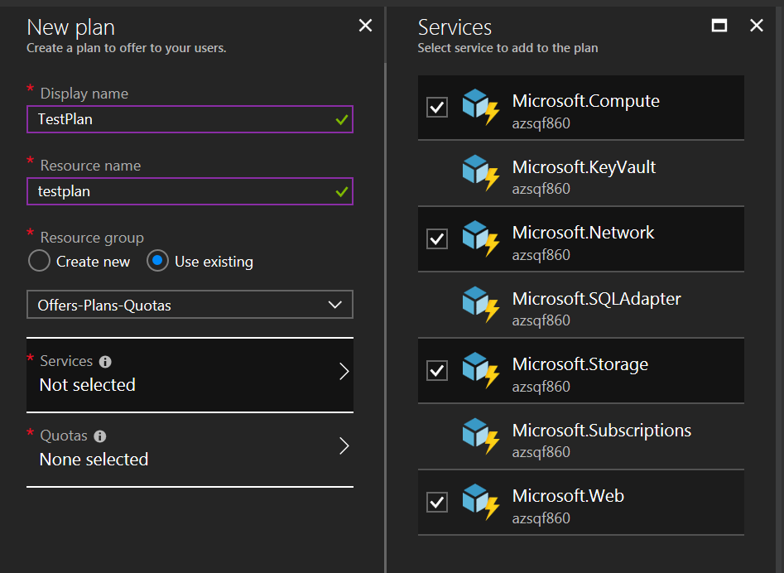
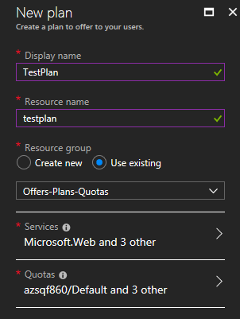
2 – Create a plan
Assign some services to the plan based on quotas…

Slide 27
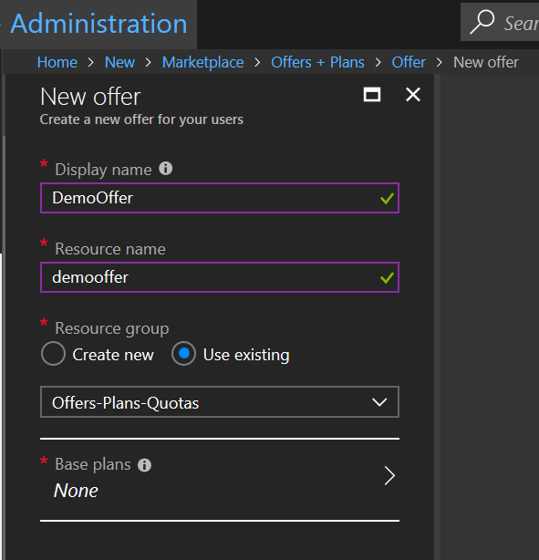
3 – Create an offer
Add one or more plans to the offer

Slide 28
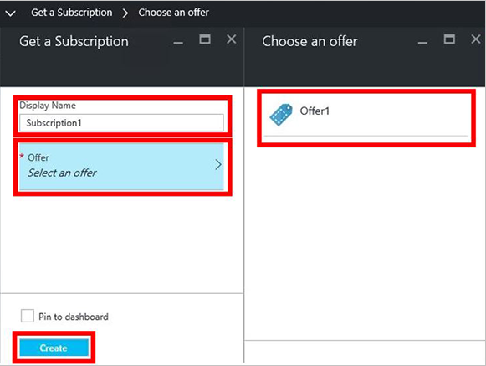
4 – Subscription Creation – Initiated by a user
The user can create their own name for the subscription and pick their offer…
Read More at aka.ms/Azurestack/Subscribe

Slide 29
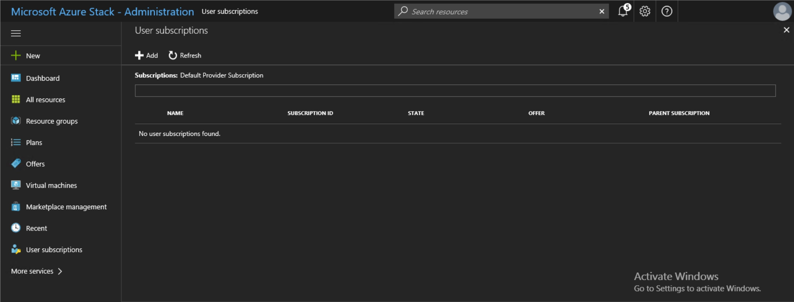
5 – Subscription creation – Initiated by an admin

Slide 30
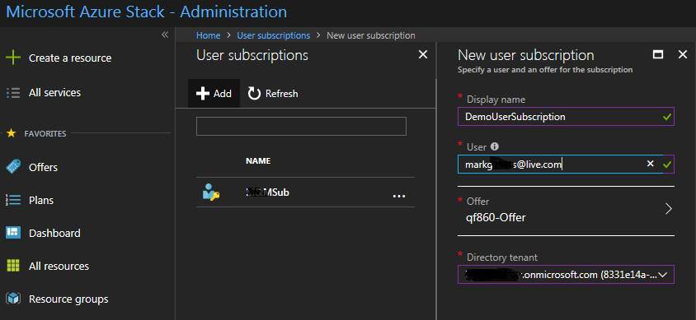
5 – Subscription creation – Initiated by an admin

Slide 31
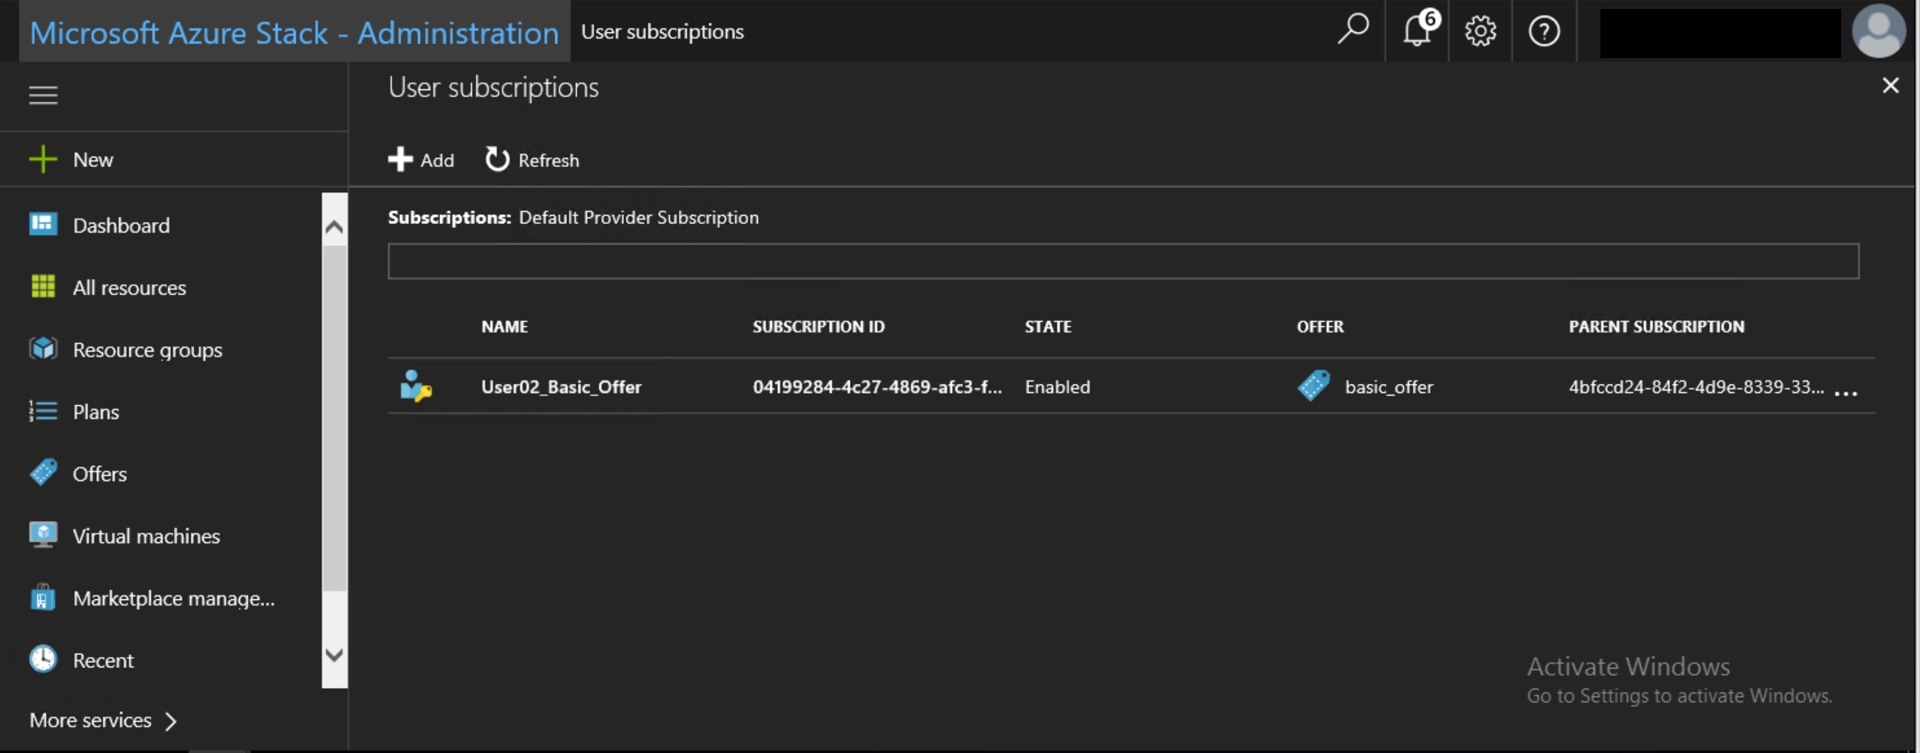
5 – Subscription creation – Initiated by an admin

Slide 32
Subscription management – PowerShell
Use the Azure Stack Hub PowerShell modules to enable or disable user subscriptions. For example, here is how to select and then disable a user’s subscription:
$sub = Get-AzsUserSubscription
$sub.State = "Disabled"
Set-AzsUserSubscription -Subscription $sub

Slide 33
Error example
writeErrorStream : True
Exception : Microsoft.Rest.Azure.CloudException: The resource namespace 'Microsoft.KeyVault' is invalid.

Slide 34
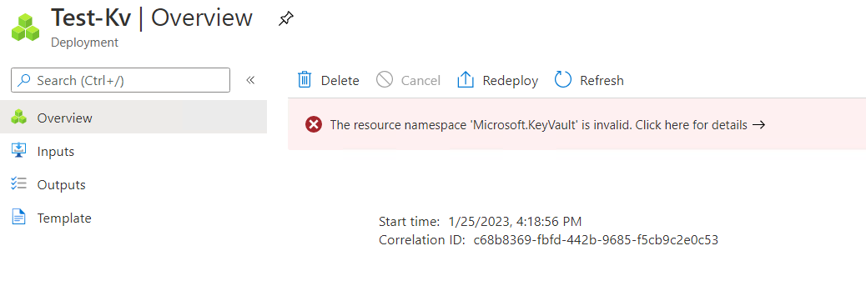
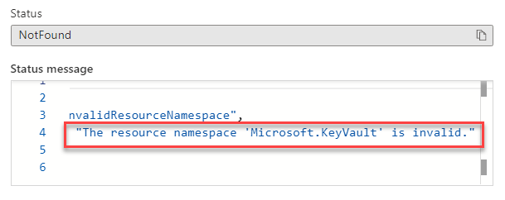
Error example

Slide 35
Provider Delegation

Slide 36
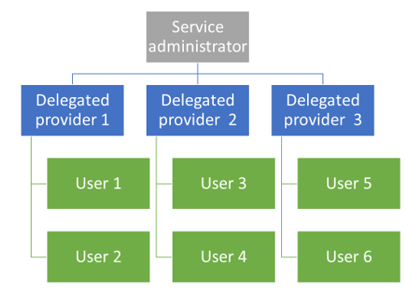
Reselling through a delegated provider
Create a delegation hierarchy to enable Delegated Providers
By default, all services are available to be resold by Delegated Providers
Ease administration by delegating to others

Slide 37



Delegation Roles
Azure Stack Hub Operator
Creates Offer Template. Delegates to…
Delegated Provider(s)
That have Owner or Contributor Subscription Rights
User(s)
Sign Up for Offers. Create Resources
aka.ms/AzureStack/Delegate

Slide 38
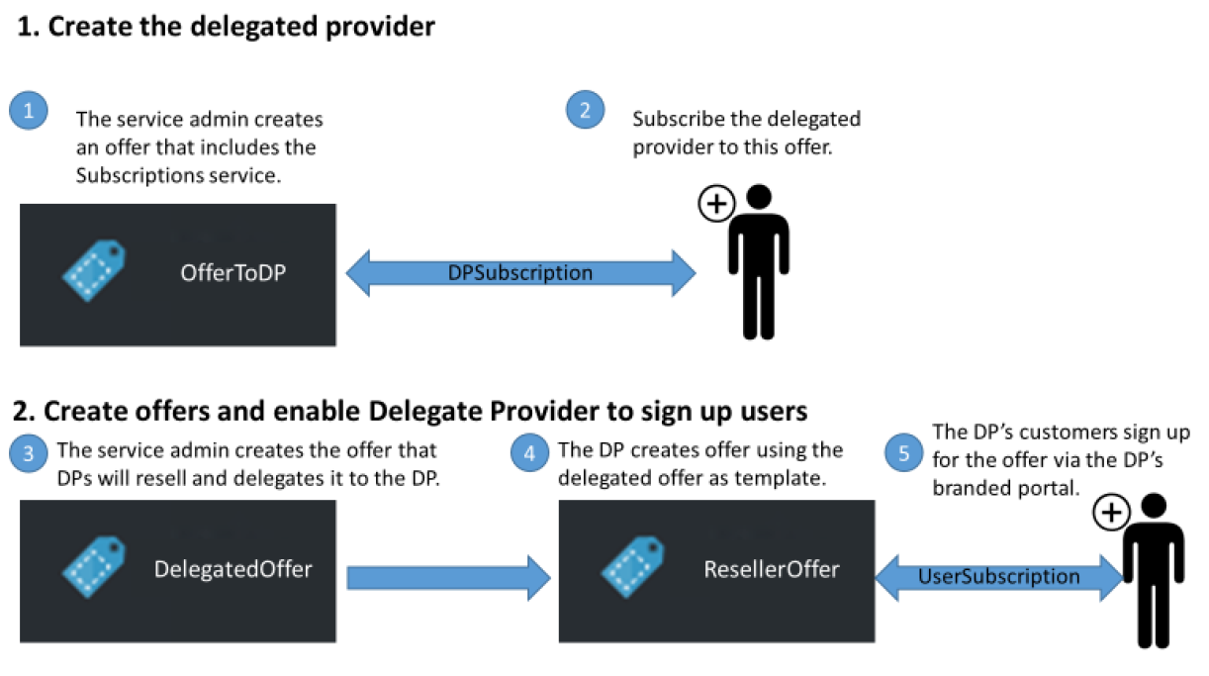
Delegation Steps

Slide 39
Automation

Slide 40
Automation PowerShell
For Backup and Rapid Redeployment
Create
Offer
Plan
Offer
Subscription to an offer
Delete Quotas, Plans, Offers and Subscriptions
Use PowerShell to manage subscriptions, plans, and offers in Azure Stack Hub - Azure Stack Hub | Microsoft Docs

Slide 41
Questions?

